Slide 1
Flower CLassification
Dr: esraa afify
Eng : Mostafa

Slide 2
Team members
Osama Ayman 205028
Elsam said 205018
Omar Essam 205008

Slide 3
Introduction
The idea of the project is to be able to extract flowers names and families from a text book and also extract there features like length color by segmenting the book is words and find the said by its indexs

Slide 4
┌─────────────────┐
│ import the book
└─────────────────┘ pipeline
│
▼
┌─────────────────┐
│ segmenting the book
└─────────────────┘
│
▼
┌─────────────────┐
│ Extract names and families
└─────────────────┘
│
▼
┌─────────────────┐
│Extract the features for Each of them
└─────────────────┘
│
▼
┌─────────────────┐
│ Test & Evaluate
└─────────────────┘

Slide 5
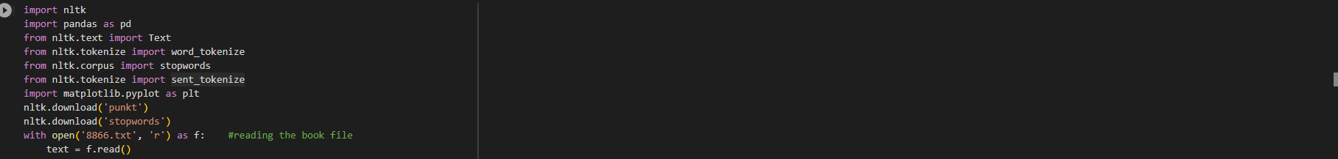
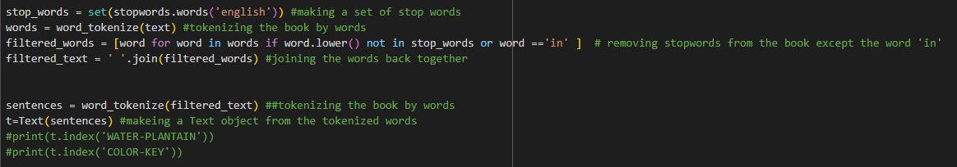
Importing the libraires and Reading the book
Tokenizing the book

Slide 6
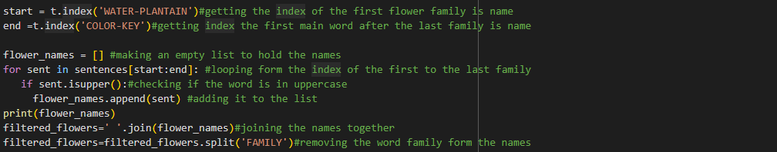
Getting The Names of the families

Slide 7
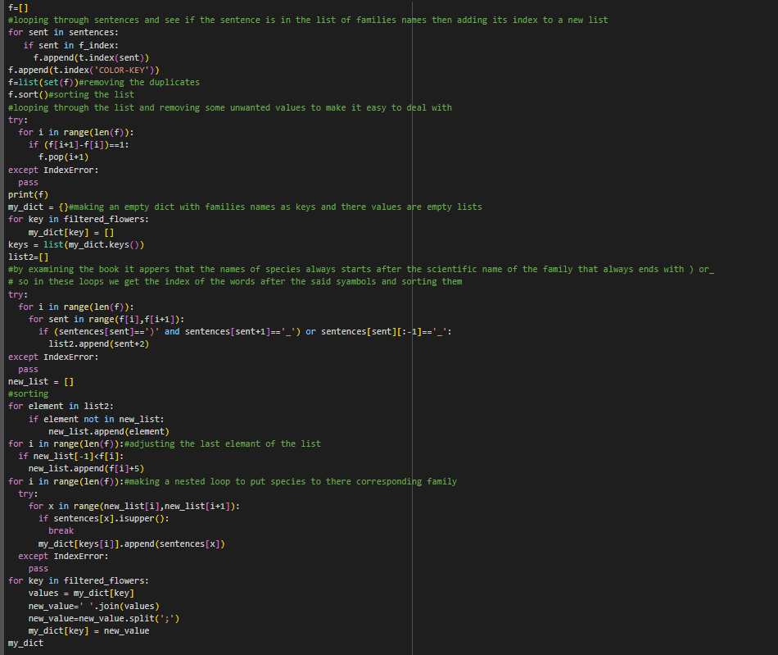
Getting the names of each species and making a dictionary with Family is name as the key and its belonging species as a list of values

Slide 8
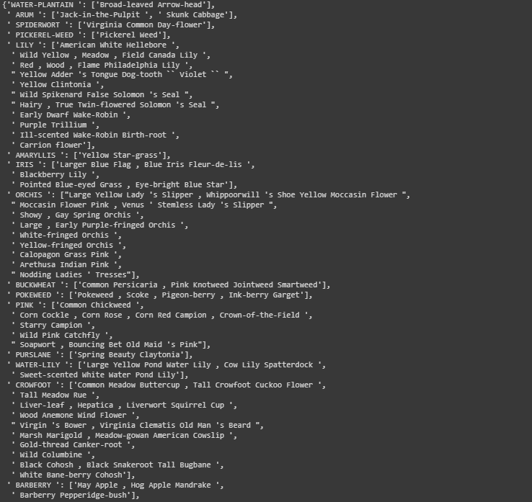
OUTPUT SAMPLE

Slide 9
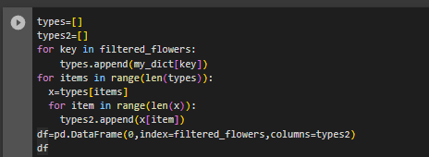
making an panda df for familes and species
checking if the names of rows are in the dict and changing the value of the columns that have the same name as there value in the dict to 1
getting the total number of species for each family

Slide 10
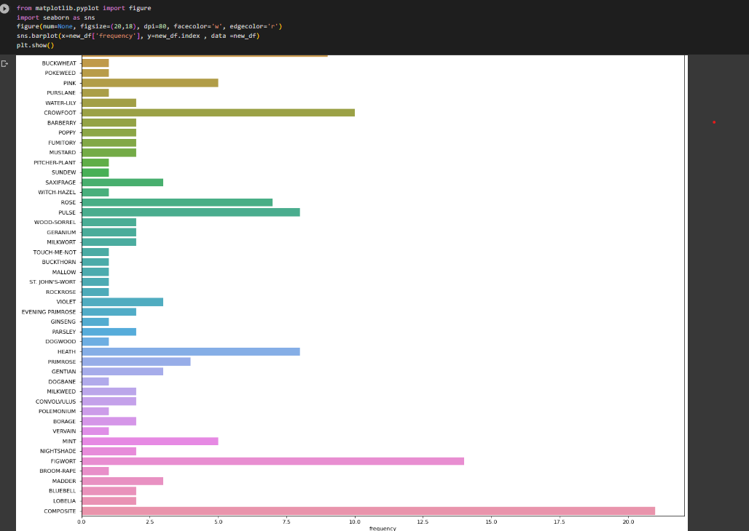
Plotting The Number of flowers par family

Slide 11
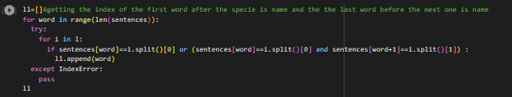
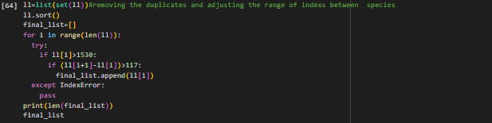
#getting the index of the first word after the specie is name and the the last word before the next one is name
#removing the duplicates and adjusting the range of indexs between species

Slide 12
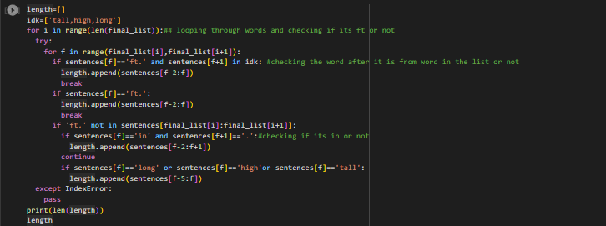

#Getting the length of the flower
#looping to covert all values from ft to in by multiplying them by 12

Slide 13
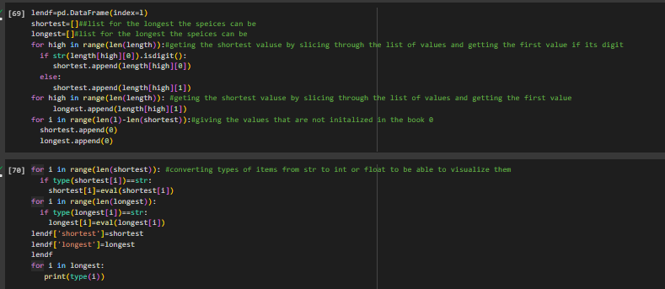
Getting the average length and how tall and short each flower can be
Converting their str to int or float to plot them

Slide 14
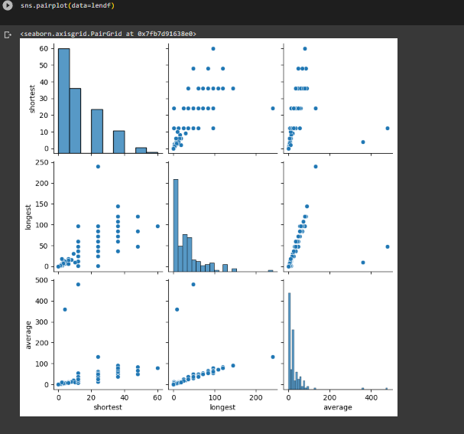
Pair Plotting the average , longest and shortest

Slide 15
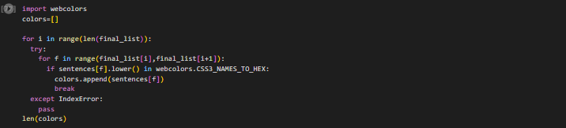

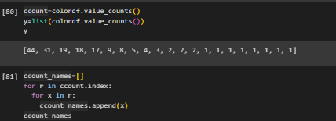

Getting the color of each flower
Making a df out of the colors and the flowers
Counting the number of colors to know the most common and rarest colors
Making a df from colors and there frequancy

Slide 16
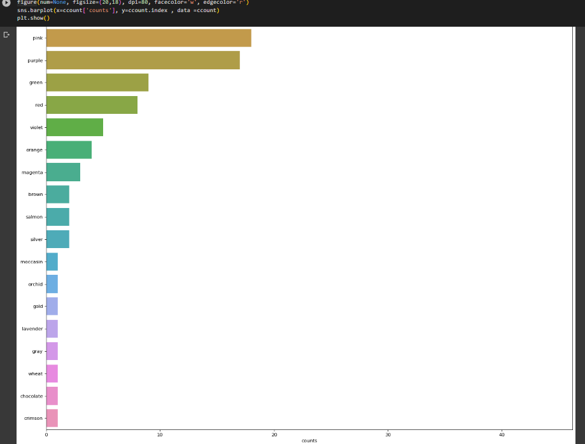
Plotting the colors

Slide 17
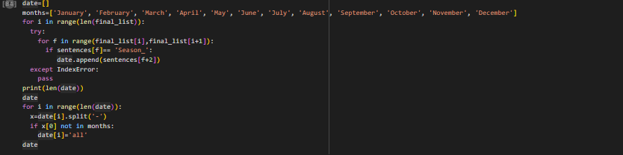
Getting the dates of flowering season of each flower

Slide 18
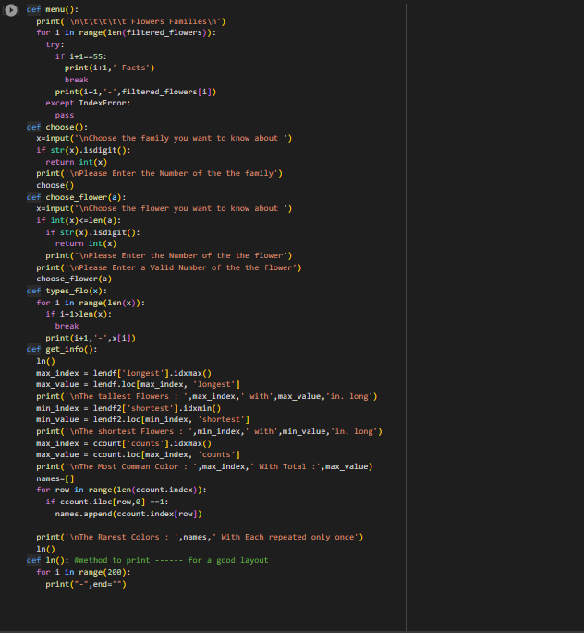
Making Function

Slide 19
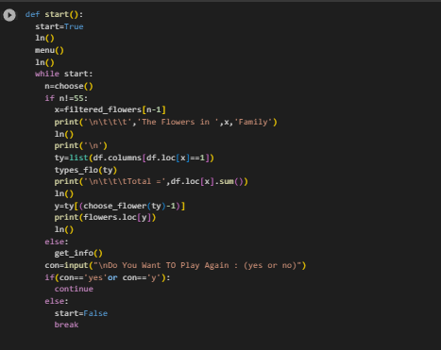
Start Method

